Slide 1

Report on
Business Analytics Capstone Project
(Using R)
Domain – Business Analytics
Project ID : CP5
Navdeep Thakur
Submitted on 5July2018
Mentor : S Ojha

Slide 2

BUSINESS ANALYTICS CAPSTONE PROJECT REPORT
Market Campaign
1. AN INTRODUCTION

Slide 3
BUSINESS ANALYTICS CAPSTONE PROJECT REPORT
1. AN INTRODUCTION
1.1 Project Brief
The data is related with marketing campaigns
The marketing campaigns were based digitally
To determine if the product is Purchased (Yes) or not Purchased (No)
1.2 Objective of the Study
To Find out which customer will purchase the product and which customer will not purchase

Slide 4
BUSINESS ANALYTICS CAPSTONE PROJECT REPORT
1.3 Approach of the Study
Steps Involved:
Reading the data
Analysing the data: EDA (Univariate/Bivariate statistics, box plot, histogram, scatter plot):
Variable identification (Dependent, Independent variables)
Distribution of numerical variable (box plot, histogram)
Counting no. of categorical variable
Find out no. of missing values/blanks
Find out no. of outliers, outlier treatment if required

Slide 5
BUSINESS ANALYTICS CAPSTONE PROJECT REPORT
Approach of the Study
3. Data Preparation:
Treatment of outliers, missing value, etc. (If distribution is normal, use mean for missing value replacement. If dist. is skewed, use median. For missing value of categorical variable, replacement can be done by mode.)
Variable transformation (if required, if variable is not linear to make it linear)
Create new variables if required
Convert categorical to Numeric (dummy variable creation: n-1, where n is no. of categories within a categorical variable)
4. Dividing data into Train & Test data sets
5. Checking for multicollinearity (Vif should be less than 5 or 10)
6. Building the model on train dataset (ensure no multicollinearity) and using technique such as :
Logistic regression, decision trees, random forest

Slide 6
BUSINESS ANALYTICS CAPSTONE PROJECT REPORT
Approach of the Study
7. Evaluating the model (using Confusion Matrix, AUC, ROC curve, KS curve)
8. Apply model on Test dataset

Slide 7
BUSINESS ANALYTICS CAPSTONE PROJECT REPORT
1.4 Scope and Limitation of the Study
Scope is limited to the available dataset. Model has been tested on the test dataset as we have limitation of getting actual real-time data to evaluate model performance on actual data from a live source.

Slide 8

BUSINESS ANALYTICS CAPSTONE PROJECT REPORT
2. DATA EXPLORATION

Slide 9
BUSINESS ANALYTICS CAPSTONE PROJECT REPORT
1. Reading data:
setwd(“path")
# Getting working directory
getwd()
# Reading the data file and storing the same to object data
data = read.csv("market campaign.csv")
# Few commands to get overview of data
View(data)
str(data)
summary(data)
head(data)
tail(data)

Slide 10
BUSINESS ANALYTICS CAPSTONE PROJECT REPORT
1. R Output:
> str(data)
'data.frame': 4483 obs. of 10 variables:
$ age : int 30 33 35 30 59 35 36 39 41 43 ...
$ job : Factor w/ 12 levels "","admin.","blue-collar",..: 12 9 6 6 3 6 8 11 4 9 ...
$ marital : Factor w/ 4 levels "","divorced",..: 3 3 4 3 3 4 3 3 3 3 ...
$ education : Factor w/ 5 levels "","primary","secondary",..: 2 3 4 4 3 4 4 3 4 2 ...
$ contact : Factor w/ 4 levels "","cellular",..: 2 2 2 4 4 2 2 2 4 2 ...
$ days_since._signed_in: int 19 11 16 3 5 23 14 6 14 17 ...
$ Time.spend.on.website: int 79 220 185 199 226 NA 341 151 57 313 ...
$ Number_of_campaigns : int 1 1 1 4 1 2 1 2 2 1 ...
$ previous_purchases : int 0 4 1 0 0 3 2 0 0 2 ...
$ Purchase_Made : Factor w/ 3 levels "","no","yes": 2 2 2 2 2 2 2 2 2 2 ...

Slide 11
BUSINESS ANALYTICS CAPSTONE PROJECT REPORT
Analyse the data: EDA (univariate/bivariate statistics, box plot, histogram, scatter plot)
In the dataset, we have:
4483 records, 9 independent variables, and dependent variable: Purchase_Made
Following are histogram and boxplot for variable age, we can see, age is normally distributed, there are few outliers, but we keep them as it is as we do not want to alter our original data much.
Similarly plots for other variables can be done
R code:
hist(data$age)
#so age is nearly normally distributed
summary(data$age)
#Replacing NAs with mean as age is normally distributed
data$age[is.na(data$age)]=41
summary(data$age)
#Now missing values of variable age is replaced with mean
#Checking for outliers
boxplot(data$age)

Slide 12
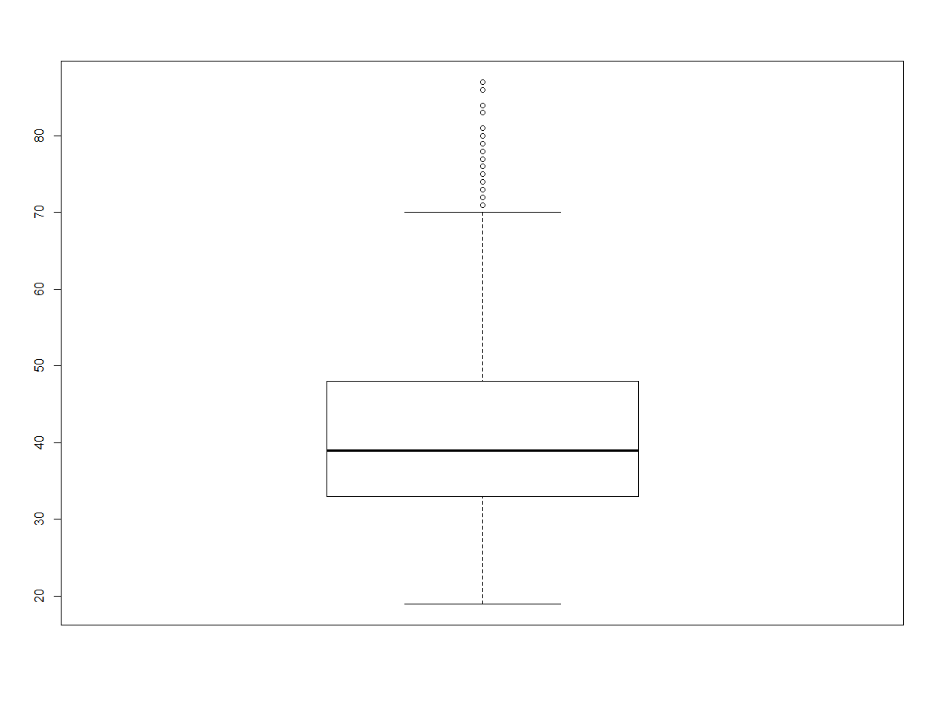
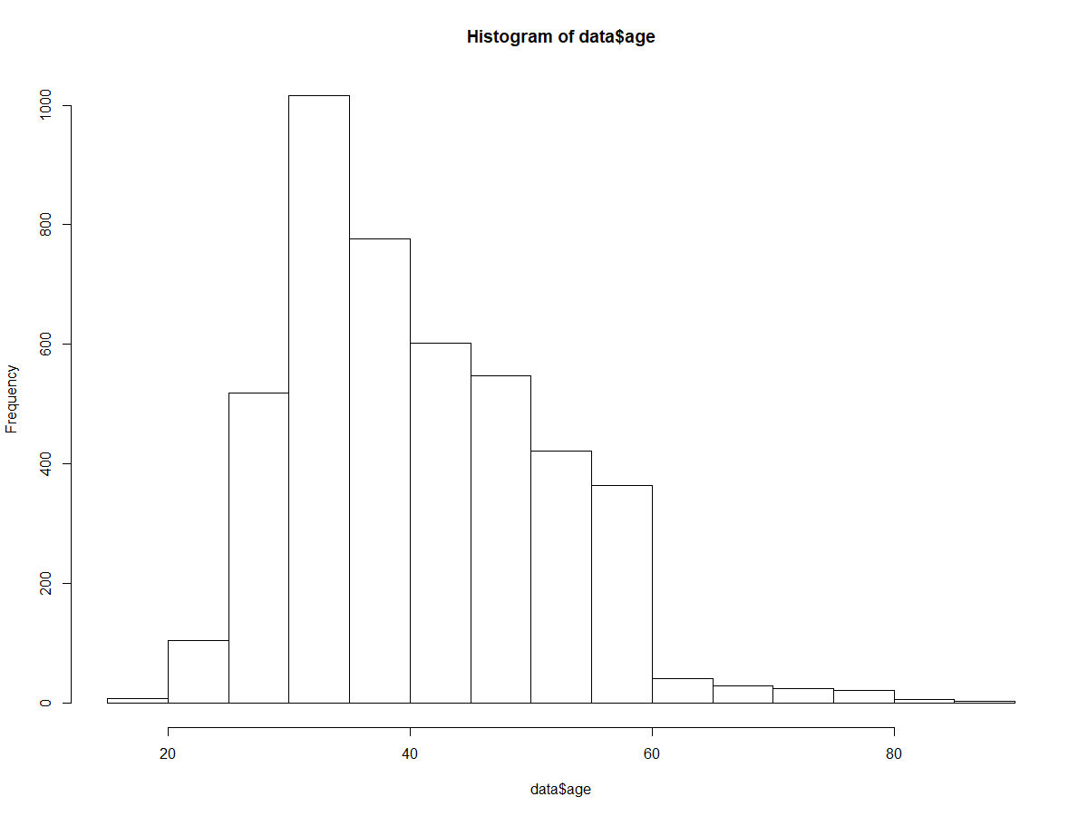
BUSINESS ANALYTICS CAPSTONE PROJECT REPORT
R output:

Slide 13
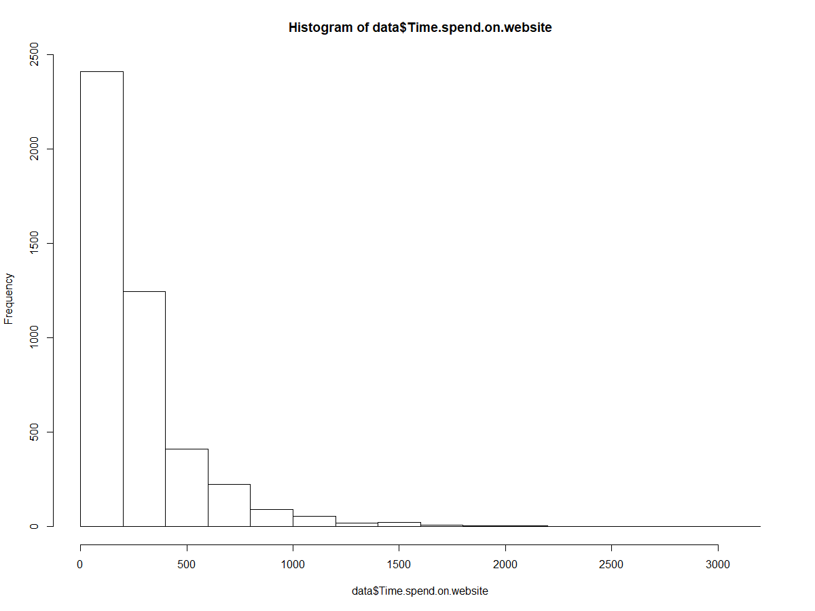
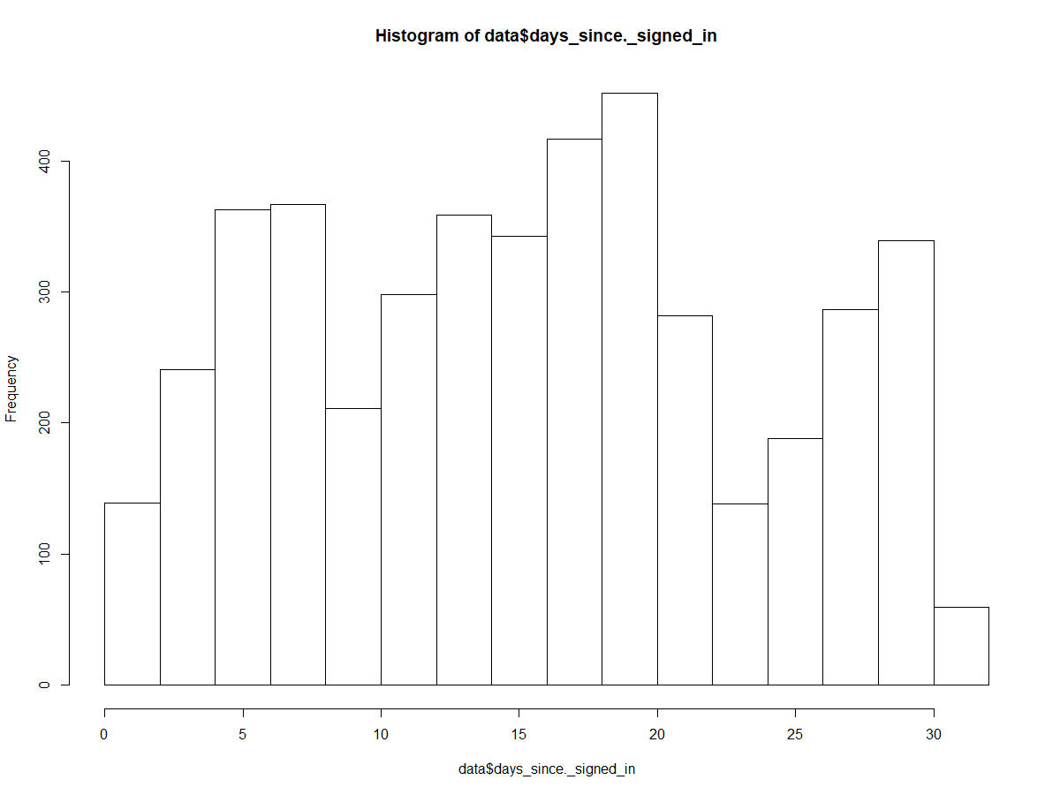
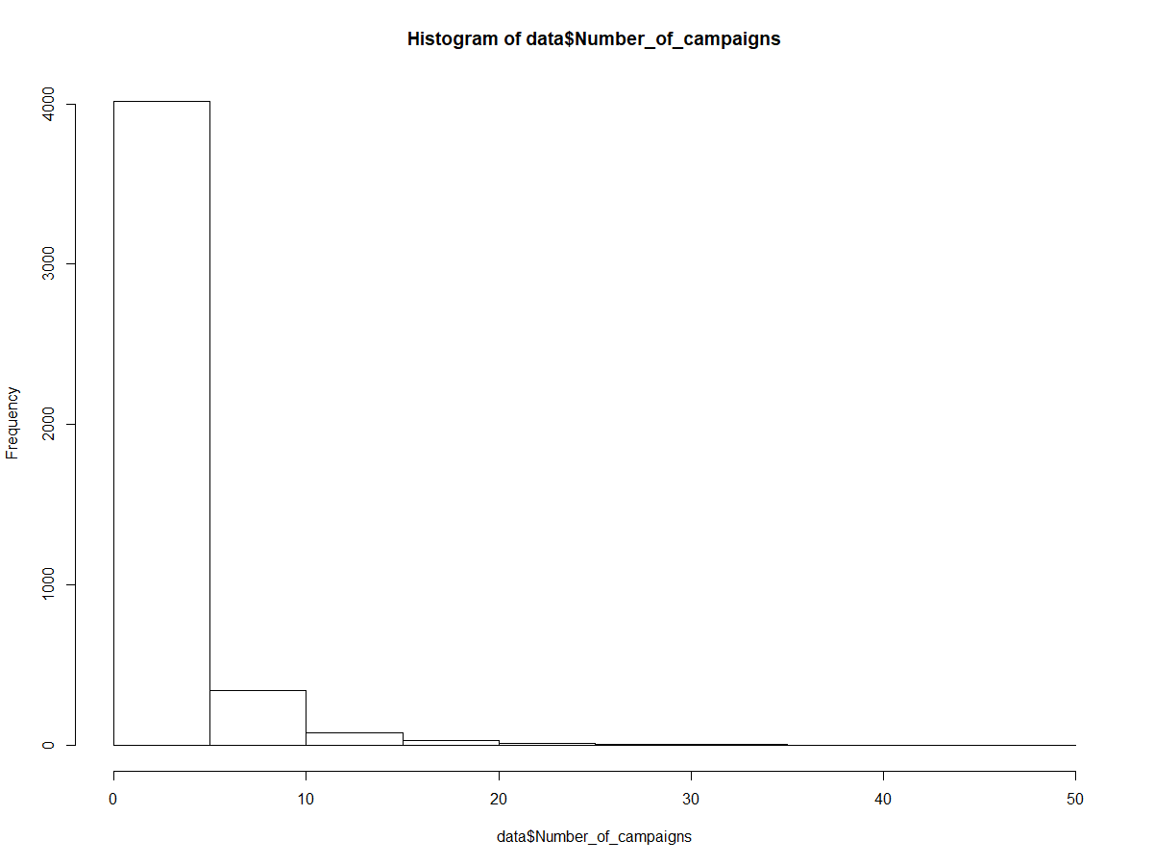
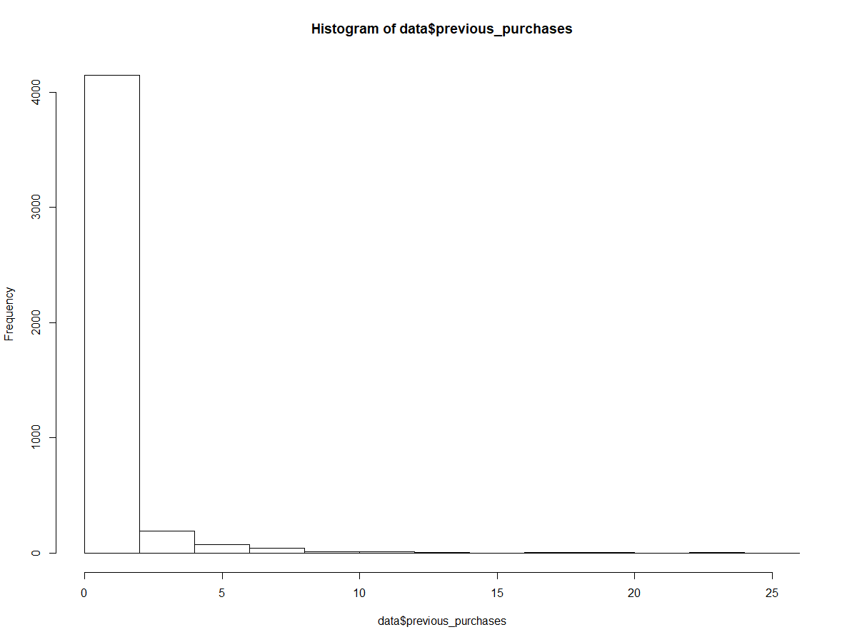
BUSINESS ANALYTICS CAPSTONE PROJECT REPORT

Slide 14
BUSINESS ANALYTICS CAPSTONE PROJECT REPORT
Missing value treatment e.g.:
R code:
data$days_since._signed_in[is.na(data$days_since._signed_in)]=15.91
summary(data$days_since._signed_in)
summary(data$Time.spend.on.website)
hist(data$Time.spend.on.website)
data$Time.spend.on.website[is.na(data$Time.spend.on.website)]=185

Slide 15

3. DATA VISUALISATION

Slide 16
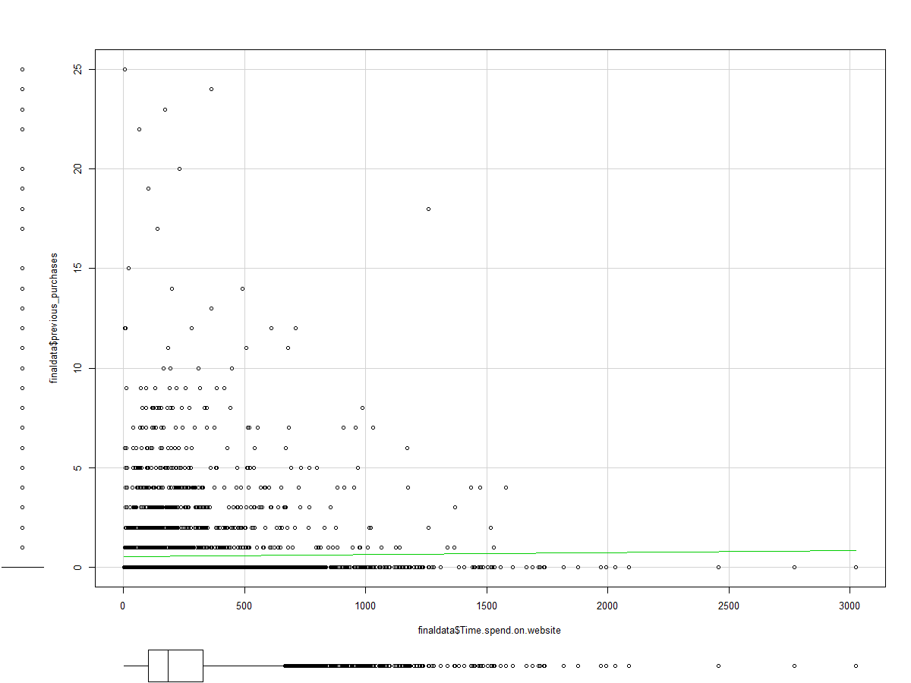
BUSINESS ANALYTICS CAPSTONE PROJECT REPORT
Relationship between previous purchase and time spent on website
R code:
scatterplot(finaldata$age,finaldata$Purchase_Made)
scatterplot(finaldata$age,finaldata$Time.spend.on.website)

Slide 17
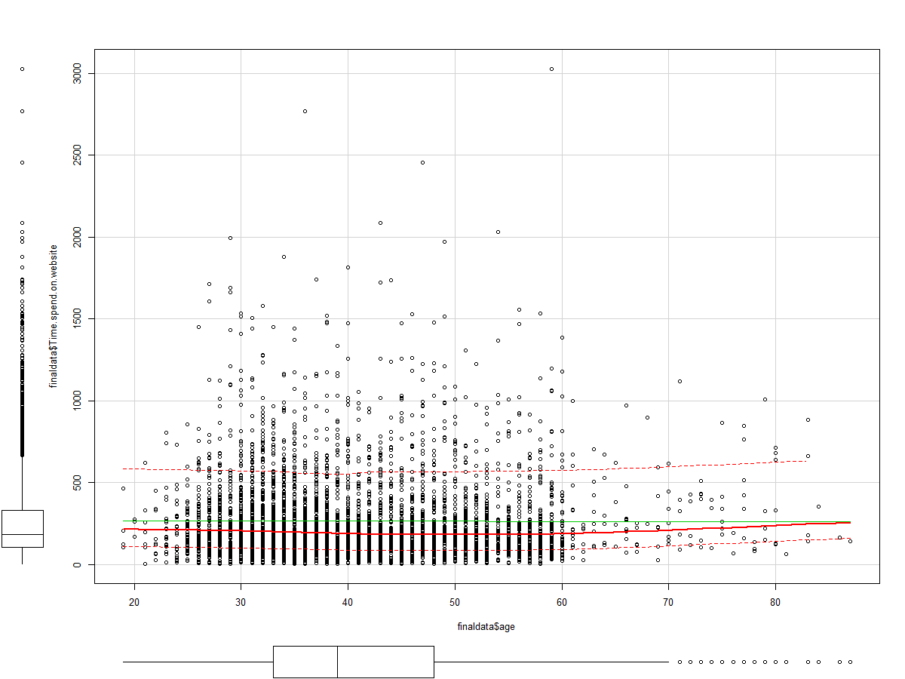
BUSINESS ANALYTICS CAPSTONE PROJECT REPORT
Relationship between age and time spent on website

Slide 18

BUSINESS ANALYTICS CAPSTONE PROJECT REPORT
4. DATA CLEANING AND PREPARATION

Slide 19
BUSINESS ANALYTICS CAPSTONE PROJECT REPORT
4. Treatment of outliers, missing value, etc.
So prima-facie post analyzing the data, we could see that there are few NAs (i.e. missing values) and blanks in the data. So next step is to treat these missing values.
Replacing NAs with mean as age is normally distributed.
Also, we can delete those records where there are missing values provided such records form smaller proportion (say <1%) of total records.
There are few outliers, but we keep them as it is as we do not want to alter our original data much.
Converting categorical variables to Numeric (by dummy variable creation)
R code:
summary(data$days_since._signed_in)
hist(data$days_since._signed_in)
data$days_since._signed_in[is.na(data$days_since._signed_in)]=15.91
summary(data$days_since._signed_in)
summary(data$Time.spend.on.website)

Slide 20
BUSINESS ANALYTICS CAPSTONE PROJECT REPORT
hist(data$Time.spend.on.website)
data$Time.spend.on.website[is.na(data$Time.spend.on.website)]=185
summary(data$Time.spend.on.website)
summary(data$Number_of_campaigns)
hist(data$Number_of_campaigns)
data$Number_of_campaigns[is.na(data$Number_of_campaigns)]=2
summary(data$Number_of_campaigns)
summary(data$previous_purchases)
hist(data$previous_purchases)
data$previous_purchases[is.na(data$previous_purchases)]=0
summary(data$previous_purchases)
summary(data)
View(data)
#deleting missing value records
data1=data[-c(740,40,116,3176,170,211,56,131,251,547,491,3177,157,119,306,142,93),]

Slide 21
BUSINESS ANALYTICS CAPSTONE PROJECT REPORT
#Dummy variable creation:
data1$admin. = ifelse(data1$job=="admin.",1,0)
data1$bluecollar = ifelse(data1$job == "blue-collar",1,0)
data1$entrepreneur = ifelse(data1$job == "entrepreneur",1,0)
data1$housemaid = ifelse(data1$job == "housemaid",1,0)
data1$management = ifelse(data1$job == "management",1,0)
data1$retired = ifelse(data1$job == "retired",1,0)
data1$selfemployed = ifelse(data1$job == "self-employed",1,0)
data1$services = ifelse(data1$job == "services",1,0)
data1$student = ifelse(data1$job == "student",1,0)
data1$technician = ifelse(data1$job == "technician",1,0)
View(data1)
summary(data1$marital)
data1$married = ifelse(data1$marital == "married",1,0)
data1$single = ifelse(data1$marital == "single",1,0)
summary(data1$education)
data1$primary = ifelse(data1$education == "primary",1,0)
data1$secondary = ifelse(data1$education == "secondary",1,0)
data1$tertiary = ifelse(data1$education == "tertiary",1,0)
summary(data1$contact)
data1$cellular = ifelse(data1$contact == "cellular",1,0)
data1$telephone = ifelse(data1$contact == "telephone",1,0)
View(data1)
data1$Purchase_Made = ifelse(data1$Purchase_Made == "no",0,1)
table(data$Purchase_Made)
View(data1)
finaldata=data1[-c(2:5)]

Slide 22

BUSINESS ANALYTICS CAPSTONE PROJECT REPORT
5. DATA MODELLING

Slide 23
BUSINESS ANALYTICS CAPSTONE PROJECT REPORT
Divide data into train & Test & Checking for multicollinearity (Vif should be less than 5/10 as the may be)
Building the model on train dataset (ensure no multicollinearity) and use technique (logistic regression, decision trees, random forest)
Rcode:
set.seed(9)
t=sample(1:nrow(finaldata),0.7*nrow(finaldata))
t_train=finaldata[t,]
t_test=finaldata[-t,]
#Biulding model on train dataset
mod= lm(Purchase_Made ~ ., data = t_train)
summary(t_train)
#Checking multicollinearity
t = vif(mod)
sort(t, decreasing = T)
#Removing variables with vif>5 to reduce multicollinearity
finaldata1=finaldata[-c(11,20,21,8,16)]

Slide 24
BUSINESS ANALYTICS CAPSTONE PROJECT REPORT
1. Data from which all Missing Values were removed

Slide 25
BUSINESS ANALYTICS CAPSTONE PROJECT REPORT
Post missing value replacement/removal, we have below dataset
Missing value removal and r code for same already explained in earlier slide

Slide 26
BUSINESS ANALYTICS CAPSTONE PROJECT REPORT
2. Data for which missing values were predicted using MICE

Slide 27
BUSINESS ANALYTICS CAPSTONE PROJECT REPORT
Missing value visualization using MICE:
R code:
#Missing values visvualization
library(mice)
md.pattern(data)
?md.pattern
library(VIM)
?aggr
aggr(data,numbers=TRUE, prop=FALSE)
matrixplot(data)
mice_plot <- aggr(data, col=c('navyblue','yellow'),
numbers=TRUE, sortVars=TRUE,
labels=names(data), cex.axis=.7,
gap=3, ylab=c("Missing data","Pattern"))

Slide 28
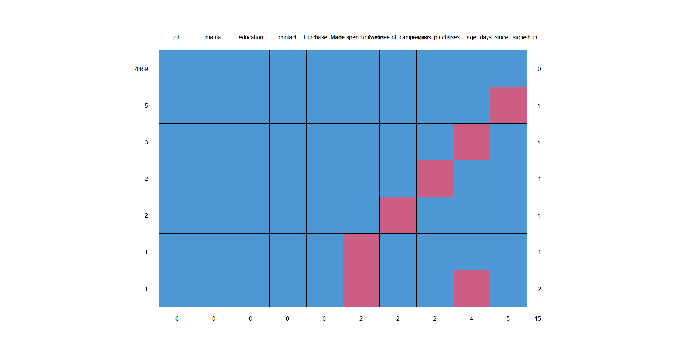
BUSINESS ANALYTICS CAPSTONE PROJECT REPORT

Slide 29
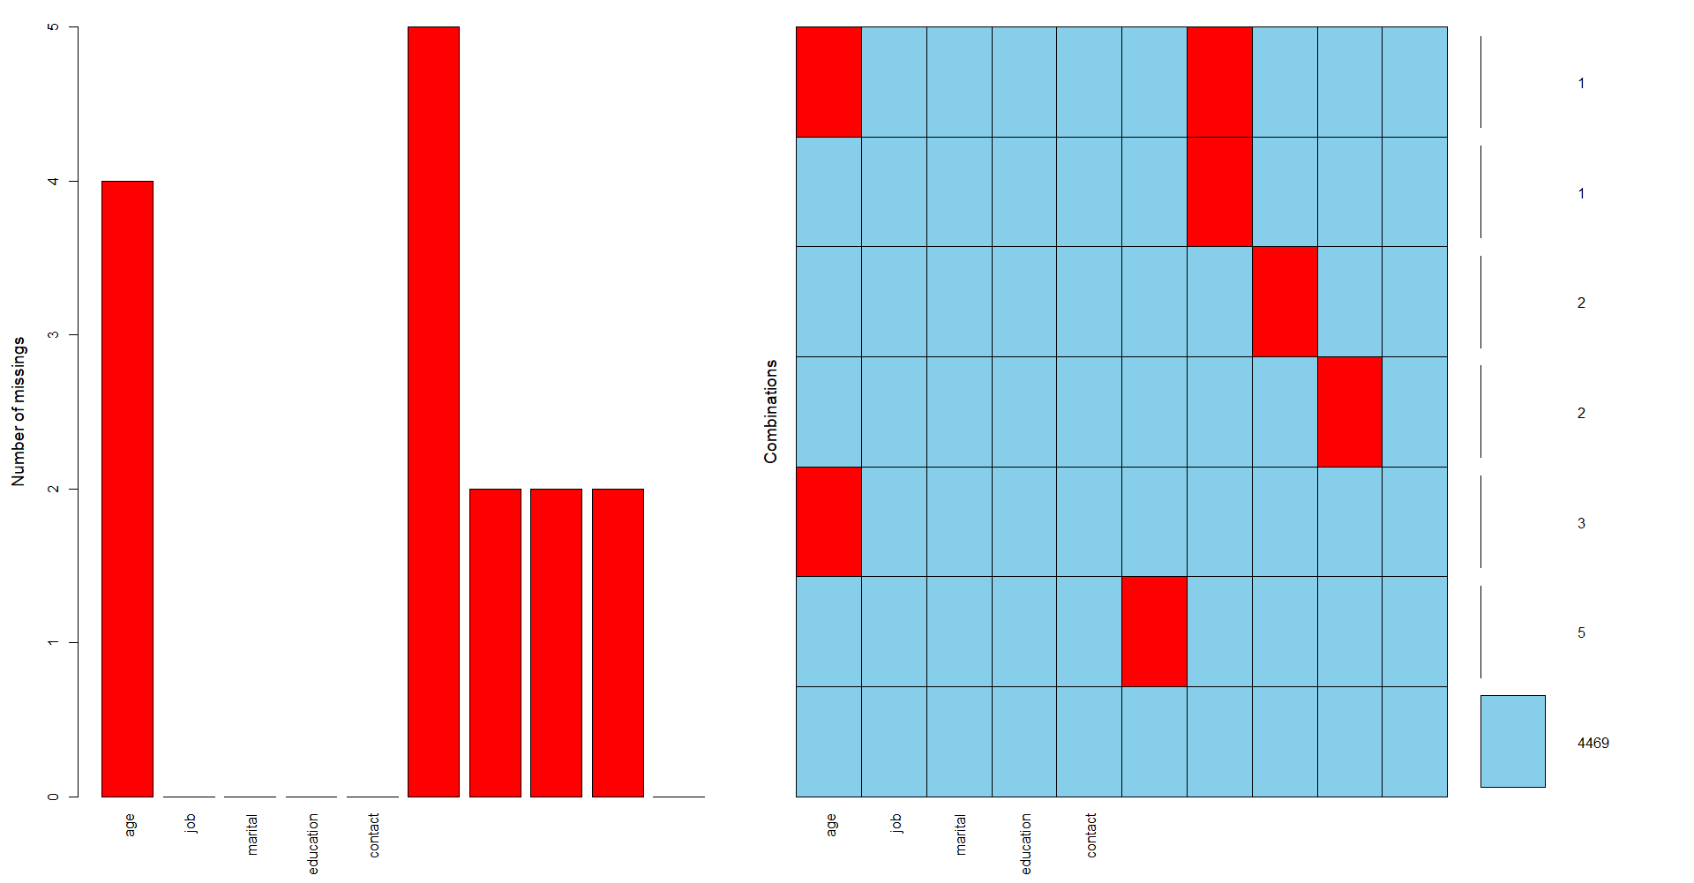
BUSINESS ANALYTICS CAPSTONE PROJECT REPORT
Missing value visualization using MICE:

Slide 30
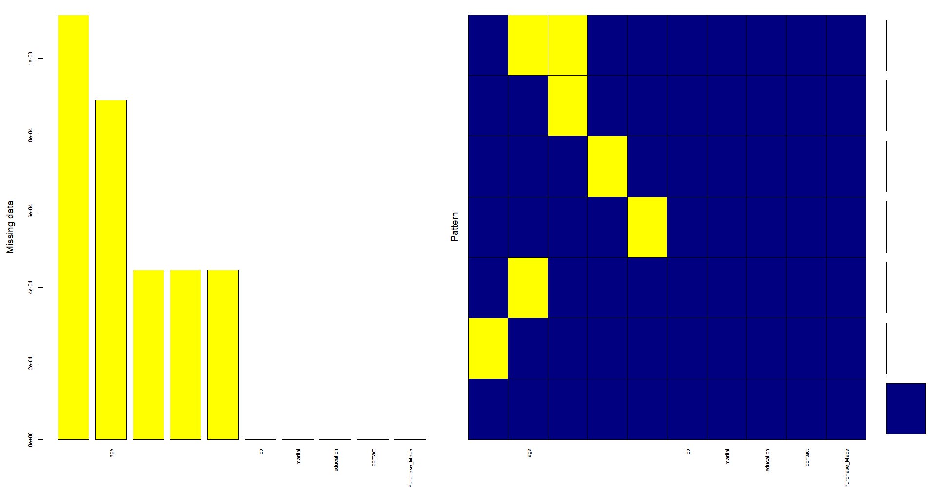
BUSINESS ANALYTICS CAPSTONE PROJECT REPORT
Missing value visualization using MICE:

Slide 31
BUSINESS ANALYTICS CAPSTONE PROJECT REPORT
3. Data after removal of outliers (missing values predicted dataset)

Slide 32
BUSINESS ANALYTICS CAPSTONE PROJECT REPORT
As observed earlier, some variables such as age has some outliers. However, we chose to retain them as it is to have realistic feature in the model since real time data in fact can have outliers too.
Attached below is final data for model building. This final data is obtained after treating missing values and converting categorical variable into numeric variable through use of dummy variables.

Slide 33
BUSINESS ANALYTICS CAPSTONE PROJECT REPORT
Applying logit model for prediction:
R code:
mod1 <- glm(as.factor(Purchase_Made) ~ ., family="binomial", data=t_train)
summary(mod1)
stpmod = step(mod1, direction = "both")
formula(stpmod)
summary(stpmod)
mod2 <- glm(as.factor(Purchase_Made) ~ age + Time.spend.on.website + Number_of_campaigns + previous_purchases + admin. + retired + student + married + primary + cellular + telephone , family="binomial", data=t_train)
t_train$score=predict(mod2,newdata=t_train,type = "response")
head(t_train$score)
tail(t_train$score)
library(lattice)
library(ggplot2)
library(caret)
library(e1071)
prediction = ifelse(t_train$score>=0.12,1,0)
confusionMatrix(factor(prediction),factor(t_train$Purchase_Made), positive = "1")
prediction = ifelse(t_train$score>=0.52,1,0)
confusionMatrix(factor(prediction),factor(t_train$Purchase_Made), positive = "1")

Slide 34
BUSINESS ANALYTICS CAPSTONE PROJECT REPORT
Model output on train data set:
Confusion Matrix and Statistics
Reference
Prediction 0 1
0 2729 296
1 40 61
Accuracy : 0.8925
95% CI : (0.8811, 0.9032)
No Information Rate : 0.8858
P-Value [Acc > NIR] : 0.124
Kappa : 0.2275
Mcnemar's Test P-Value : <2e-16
Sensitivity : 0.17087
Specificity : 0.98555
Pos Pred Value : 0.60396
Neg Pred Value : 0.90215
Prevalence : 0.11420
Detection Rate : 0.01951
Detection Prevalence : 0.03231
Balanced Accuracy : 0.57821
'Positive' Class : 1

Slide 35
BUSINESS ANALYTICS CAPSTONE PROJECT REPORT
R code:
library(pscl)
pR2(mod2)
library(InformationValue)
library(caret)
concor <- Concordance(t_train$Purchase_Made,t_train$score)
concor
plotROC(actuals = t_train$Purchase_Made,predictedScores = as.numeric(fitted(mod2)))
ks_plot(actuals = t_train$Purchase_Made,predictedScores = as.numeric(fitted(mod2)))
ks_stat(actuals = t_train$Purchase_Made,predictedScores = as.numeric(fitted(mod2)))

Slide 36
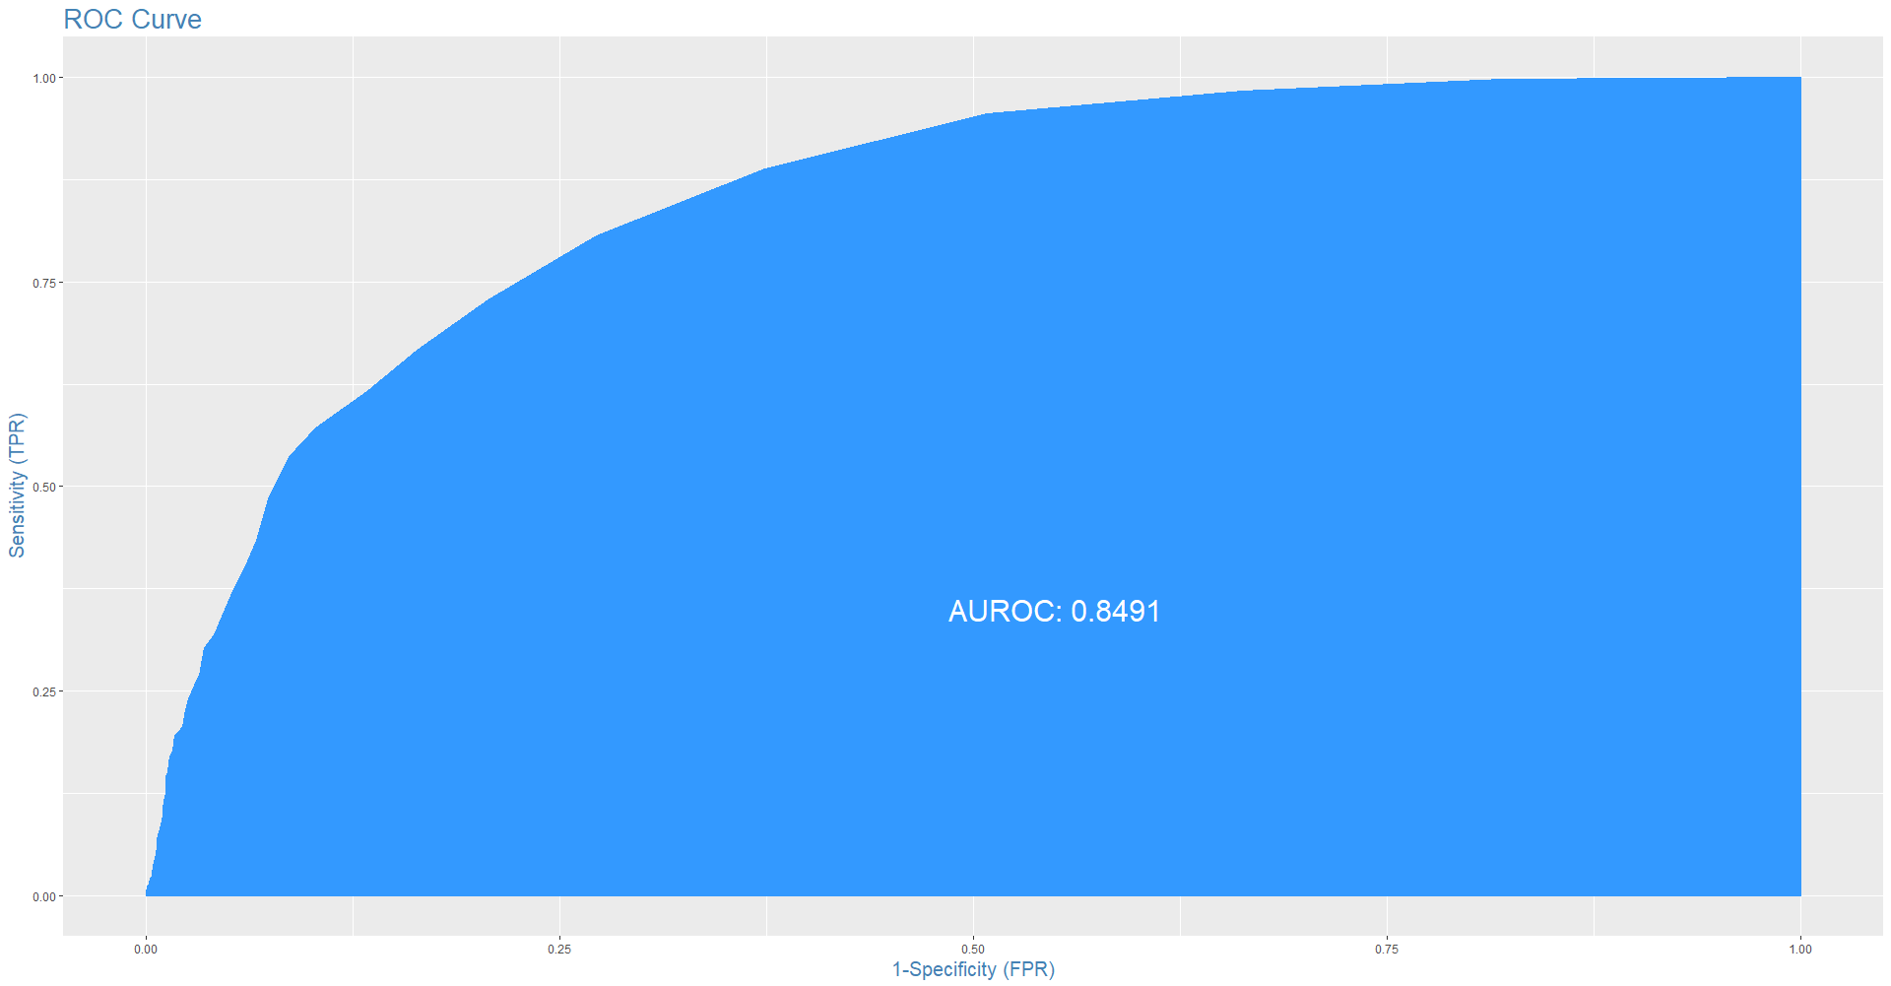
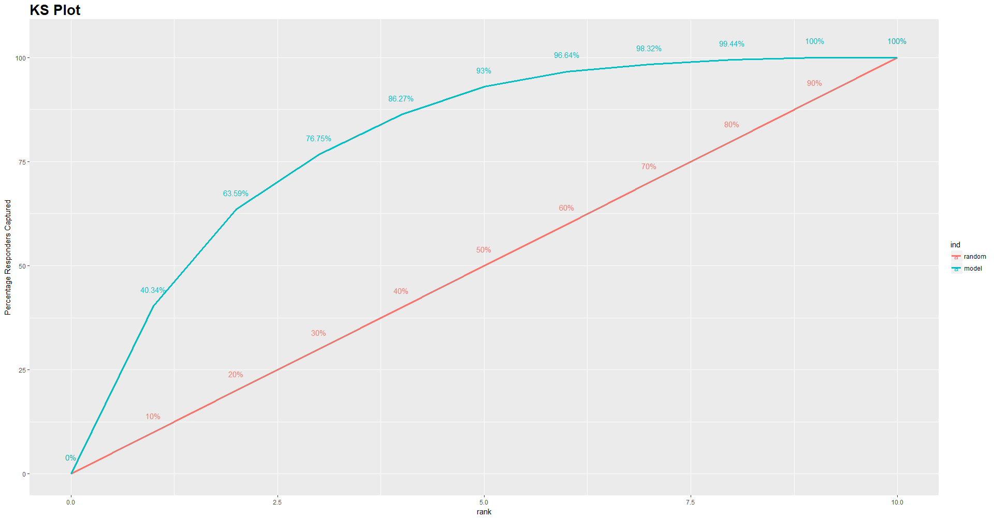
BUSINESS ANALYTICS CAPSTONE PROJECT REPORT
Model output on train dataset:
$Concordance
[1] 0.8514698
$Discordance
[1] 0.1485302
$Tied
[1] 0
$Pairs
[1] 988533
> ks_stat(actuals = t_train$Purchase_Made,predictedScores = as.numeric(fitted(mod2)))
[1] 0.5273

Slide 37
BUSINESS ANALYTICS CAPSTONE PROJECT REPORT
Applying model on test data:
Rcode:
t_test$score2= predict(mod2, t_test, type="response")
View(t_test)
prediction_test = ifelse(t_test$score2>=0.52,1,0)
View(prediction_test)
confusionMatrix(factor(prediction_test),factor(t_test$Purchase_Made),positive = "1")

Slide 38
BUSINESS ANALYTICS CAPSTONE PROJECT REPORT
Model output on test dataset:
> confusionMatrix(factor(prediction_test),factor(t_test$Purchase_Made),positive = "1")
Confusion Matrix and Statistics
Reference
Prediction 0 1
0 1169 127
1 17 27
Accuracy : 0.8925
95% CI : (0.8747, 0.9086)
No Information Rate : 0.8851
P-Value [Acc > NIR] : 0.209
Kappa : 0.2336
Mcnemar's Test P-Value : <2e-16
Sensitivity : 0.17532
Specificity : 0.98567
Pos Pred Value : 0.61364
Neg Pred Value : 0.90201
Prevalence : 0.11493
Detection Rate : 0.02015
Detection Prevalence : 0.03284
Balanced Accuracy : 0.58050
'Positive' Class : 1

Slide 39
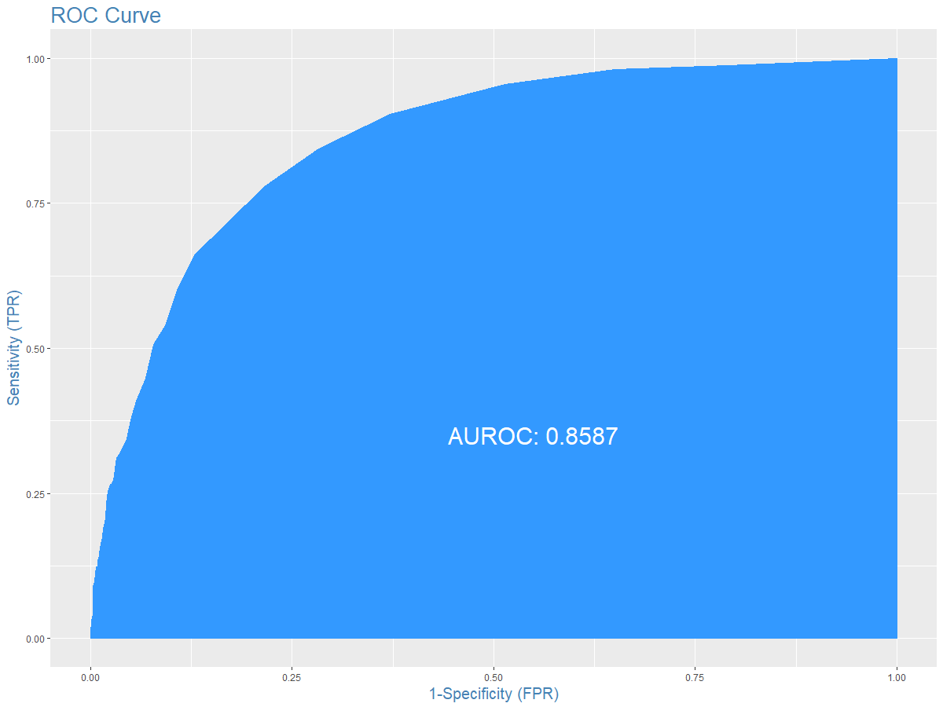
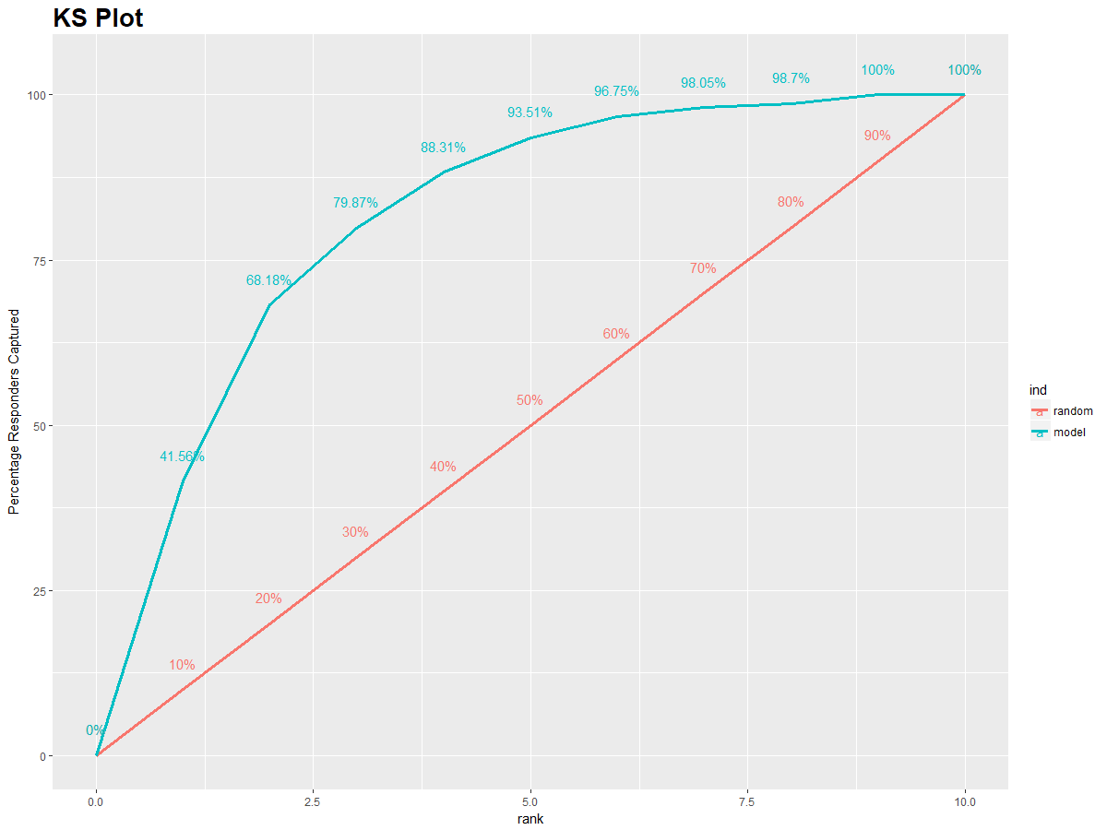
BUSINESS ANALYTICS CAPSTONE PROJECT REPORT
Model output on test dataset:
> concor <- Concordance(t_test$Purchase_Made,t_test$score2)
> concor
$Concordance
[1] 0.8613697
$Discordance
[1] 0.1386303
$Tied
[1] -2.775558e-17
$Pairs
[1] 182644
> ks_stat(actuals = t_test$Purchase_Made,predictedScores = as.numeric(t_test$score2))
[1] 0.5635

Slide 40

BUSINESS ANALYTICS CAPSTONE PROJECT REPORT
6. INSIGHTS DERIVED AND RECOMMENDATIONS

Slide 41
BUSINESS ANALYTICS CAPSTONE PROJECT REPORT
Model is 89.25% accurate in correctly identifying which customer will purchase the product and which one will not purchase
Model is 98.57% accurate in correctly identifying customers who will not purchase the product (Specificity)
However, model is only 17.53% accurate in correctly identifying customers who will purchase the product (Sensitivity)
We can improve the sensitivity by lowering the probability cut-off value, but will reduce specificity
Hence, depending on the requirement (whether to stress on customers who will not buy or on customer who will buy), we can choose an appropriate probability cut-of value to boost required accuracy parameter: Sensitivity or Specificity

Slide 42
BUSINESS ANALYTICS CAPSTONE PROJECT REPORT
7. APPENDICES

Slide 43
I. COMPILATION OF R CODE
Logistic Regression Model:
# Setting working directory
setwd(“folder path")
# Getting working directory
getwd()
# Reading the data file and storing the same to object data
data = read.csv("market campaign.csv")
# Few commands to veiw and analyze data
View(data)
str(data)
summary(data)
head(data)
tail(data)
# So prima-facie with the help of above commands, we could see that there are few NAs (i.e. missing values) and blanks in the data. So next step is to treat these missing values, for that we need to see the distribution of these variables and also need to see presence of outliers if any.

Slide 44
I. COMPILATION OF R CODE
#Missing values visvualization
library(mice)
md.pattern(data)
?md.pattern
library(VIM)
?aggr
aggr(data,numbers=TRUE, prop=FALSE)
matrixplot(data)
mice_plot <- aggr(data, col=c('navyblue','yellow'),
numbers=TRUE, sortVars=TRUE,
labels=names(data), cex.axis=.7,
gap=3, ylab=c("Missing data","Pattern"))
# Checking distribution of variables
hist(data$age)
#so age is nearly normally distributed
summary(data$age)
#Replacing NAs with mean as age is normally distributed
data$age[is.na(data$age)]=41
summary(data$age)
#Now missing values of variable age is replaced with mean

Slide 45
I. COMPILATION OF R CODE
#Checking for outliers
boxplot(data$age)
#SO there are some outliers, but keep them as it is as we do not want to alter our original data much
summary(data$days_since._signed_in)
hist(data$days_since._signed_in)
data$days_since._signed_in[is.na(data$days_since._signed_in)]=15.91
summary(data$days_since._signed_in)
summary(data$Time.spend.on.website)
hist(data$Time.spend.on.website)
data$Time.spend.on.website[is.na(data$Time.spend.on.website)]=185
summary(data$Time.spend.on.website)
summary(data$Number_of_campaigns)

Slide 46
I. COMPILATION OF R CODE
hist(data$Number_of_campaigns)
data$Number_of_campaigns[is.na(data$Number_of_campaigns)]=2
summary(data$Number_of_campaigns)
summary(data$previous_purchases)
hist(data$previous_purchases)
data$previous_purchases[is.na(data$previous_purchases)]=0
summary(data$previous_purchases)
summary(data)
View(data)
#deleting missing value records
data1=data[-c(740,40,116,3176,170,211,56,131,251,547,491,3177,157,119,306,142,93),]
write.csv(data1, file = "my_data1.csv")
View(data1)

Slide 47
I. COMPILATION OF R CODE
summary(data1$job)
str(data1$job)
table(data1$job)
#Dummy variable creation:
data1$admin. = ifelse(data1$job=="admin.",1,0)
data1$bluecollar = ifelse(data1$job == "blue-collar",1,0)
data1$entrepreneur = ifelse(data1$job == "entrepreneur",1,0)
data1$housemaid = ifelse(data1$job == "housemaid",1,0)
data1$management = ifelse(data1$job == "management",1,0)
data1$retired = ifelse(data1$job == "retired",1,0)
data1$selfemployed = ifelse(data1$job == "self-employed",1,0)
data1$services = ifelse(data1$job == "services",1,0)
data1$student = ifelse(data1$job == "student",1,0)
data1$technician = ifelse(data1$job == "technician",1,0)
View(data1)
summary(data1$marital)
data1$married = ifelse(data1$marital == "married",1,0)
data1$single = ifelse(data1$marital == "single",1,0)

Slide 48
I. COMPILATION OF R CODE
summary(data1$education)
data1$primary = ifelse(data1$education == "primary",1,0)
data1$secondary = ifelse(data1$education == "secondary",1,0)
data1$tertiary = ifelse(data1$education == "tertiary",1,0)
summary(data1$contact)
data1$cellular = ifelse(data1$contact == "cellular",1,0)
data1$telephone = ifelse(data1$contact == "telephone",1,0)
View(data1)
data1$Purchase_Made = ifelse(data1$Purchase_Made == "no",0,1)
table(data$Purchase_Made)
View(data1)
finaldata=data1[-c(2:5)]
write.csv(finaldata, file = "finaldata.csv")

Slide 49
I. COMPILATION OF R CODE
View(finaldata)
summary(finaldata)
boxplot(finaldata$married)
library(car)
scatterplot(finaldata$age,finaldata$Purchase_Made)
scatterplot(finaldata$age,finaldata$Time.spend.on.website)
#Dividing dataset into train and test data sets
set.seed(9)
t=sample(1:nrow(finaldata),0.7*nrow(finaldata))
t_train=finaldata[t,]
t_test=finaldata[-t,]

Slide 50
I. COMPILATION OF R CODE
#Biulding model on train dataset
mod= lm(Purchase_Made ~ ., data = t_train)
summary(t_train)
#Checking multicollinearity
t = vif(mod)
sort(t, decreasing = T)
#Removing variables with vif>5 to reduce multicollinearity
finaldata1=finaldata[-c(11,20,21,8,16)]
View(finaldata1)
set.seed(9)
t=sample(1:nrow(finaldata1),0.7*nrow(finaldata1))
t_train=finaldata1[t,]
View(t_train)
t_test=finaldata1[-t,]
View(t_test)
mod= lm(Purchase_Made ~ ., data = t_train)

Slide 51
I. COMPILATION OF R CODE
#Checking for multicollinearity
t = vif(mod)
sort(t, decreasing = T)
#now vif is <5, so dataset do not have much multicollinearity and now we can move ahead with model building
mod1 <- glm(as.factor(Purchase_Made) ~ ., family="binomial", data=t_train)
summary(mod1)
stpmod = step(mod1, direction = "both")
formula(stpmod)
summary(stpmod)
mod2 <- glm(as.factor(Purchase_Made) ~ age + Time.spend.on.website + Number_of_campaigns + previous_purchases + admin. + retired + student + married + primary + cellular + telephone , family="binomial", data=t_train)
summary(mod2)
t_train$score=predict(mod2,newdata=t_train,type = "response")
head(t_train$score)
tail(t_train$score)

Slide 52
I. COMPILATION OF R CODE
library(lattice)
library(ggplot2)
library(caret)
library(e1071)
prediction = ifelse(t_train$score>=0.07,1,0)
confusionMatrix(factor(prediction),factor(t_train$Purchase_Made), positive = "1")
library(pscl)
pR2(mod2)
library(InformationValue)
library(caret)
concor <- Concordance(t_train$Purchase_Made,t_train$score)
concor
plotROC(actuals = t_train$Purchase_Made,predictedScores = as.numeric(fitted(mod2)))
ks_plot(actuals = t_train$Purchase_Made,predictedScores = as.numeric(fitted(mod2)))
ks_stat(actuals = t_train$Purchase_Made,predictedScores = as.numeric(fitted(mod2)))
t_test$score2= predict(mod2, t_test, type="response")
View(t_test)

Slide 53
I. COMPILATION OF R CODE
prediction_test = ifelse(t_test$score2>=0.52,1,0)
View(prediction_test)
confusionMatrix(factor(prediction_test),factor(t_test$Purchase_Made),positive = "1")
tt = cbind(t_test,prediction_test)
View(tt)
library(pscl)
library(InformationValue)
library(caret)
concor <- Concordance(t_test$Purchase_Made,t_test$score2)
concor
plotROC(actuals = t_test$Purchase_Made,predictedScores = as.numeric(t_test$score2))
ks_plot(actuals = t_test$Purchase_Made,predictedScores = as.numeric(t_test$score2))
ks_stat(actuals = t_test$Purchase_Made,predictedScores = as.numeric(t_test$score2))
#logit model ends

Slide 54
I. COMPILATION OF R CODE
Random Forest:
#Random forest model:
library(randomForest)
modelrf <- randomForest(as.factor(Purchase_Made) ~ . , data = rf_train, do.trace=T)
modelrf
importance(modelrf)
varImpPlot(modelrf)
View(t_train)
View(t_test)
rf_train=t_train[-19]
View(rf_train)
rf_test=t_test[-19]
View(rf_test)
predrf_tr <- predict(modelrf, rf_train)
predrf_test <- predict(modelrf, rf_test)
confusionMatrix(factor(predrf_tr),factor(rf_train$Purchase_Made))
confusionMatrix(factor(predrf_test),factor(rf_test$Purchase_Made))
#end of RF

Slide 55
I. COMPILATION OF R CODE
Random Forest o/p on train data:
> confusionMatrix(factor(predrf_tr),factor(rf_train$Purchase_Made))
Confusion Matrix and Statistics
Reference
Prediction 0 1
0 2769 79
1 0 278
Accuracy : 0.9747
95% CI : (0.9686, 0.9799)
No Information Rate : 0.8858
P-Value [Acc > NIR] : < 2.2e-16
Kappa : 0.8618
Mcnemar's Test P-Value : < 2.2e-16
Sensitivity : 1.0000
Specificity : 0.7787
Pos Pred Value : 0.9723
Neg Pred Value : 1.0000
Prevalence : 0.8858
Detection Rate : 0.8858
Detection Prevalence : 0.9111
Balanced Accuracy : 0.8894
'Positive' Class : 0

Slide 56
I. COMPILATION OF R CODE
Random Forest o/p on test data:
> confusionMatrix(factor(predrf_test),factor(rf_test$Purchase_Made))
Confusion Matrix and Statistics
Reference
Prediction 0 1
0 1164 128
1 22 26
Accuracy : 0.8881
95% CI : (0.8699, 0.9044)
No Information Rate : 0.8851
P-Value [Acc > NIR] : 0.386
Kappa : 0.2145
Mcnemar's Test P-Value : <2e-16
Sensitivity : 0.9815
Specificity : 0.1688
Pos Pred Value : 0.9009
Neg Pred Value : 0.5417
Prevalence : 0.8851
Detection Rate : 0.8687
Detection Prevalence : 0.9642
Balanced Accuracy : 0.5751

Slide 57
I. COMPILATION OF R CODE
Decison tree:
library(data.table)
library(reshape2)
library(randomForest)
library(party)
library(rpart)
library(rpart.plot)
library(lattice)
require(caret)
library(pROC)
library(corrplot)
library(e1071)
library(RColorBrewer)
View(finaldata)

Slide 58
I. COMPILATION OF R CODE
Decison tree:
corrplot(cor(finaldata[,1:23]), method="circle")
fit = rpart(Purchase_Made ~ ., data = rf_train,method = "class", control = rpart.control(minsplit = 30,cp = 0.01))
rpart.plot(fit)
summary(fit)
prp(fit)
plotcp(fit)
predtr <- predict(fit,rf_train,type = "class" )
predtr
confusionMatrix(factor(predtr),factor(rf_train$Purchase_Made))
predtest <- predict(fit,rf_test, type = "class")
confusionMatrix(factor(predtest),factor(rf_test$Purchase_Made))
auctrain <- roc(as.numeric(rf_train$Purchase_Made), as.numeric(predtr))
auctest <- roc(as.numeric(rf_test$Purchase_Made), as.numeric(predtest))
plot(auctrain, ylim=c(0,1), print.thres=TRUE, main=paste('AUC:',round(auctrain$auc[[1]],3)),col = 'blue')
plot(auctest, ylim=c(0,1), print.thres=TRUE, main=paste('AUC:',round(auctest$auc[[1]],3)),col = 'blue')
#end

Slide 59
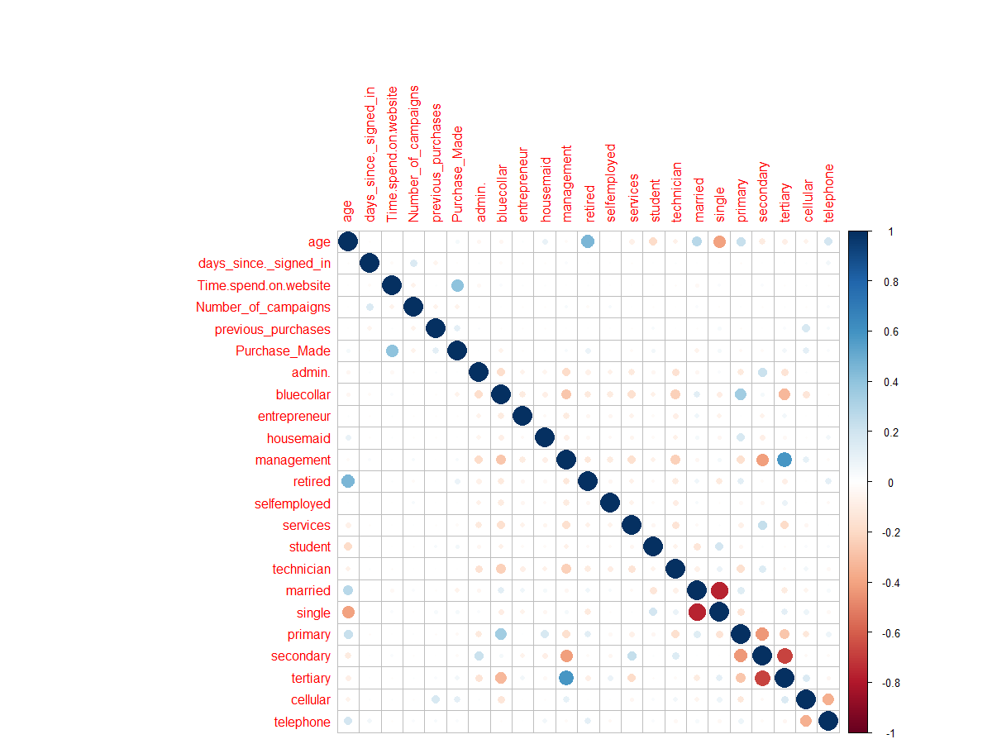
I. COMPILATION OF R CODE
Decison tree R o/p:

Slide 60
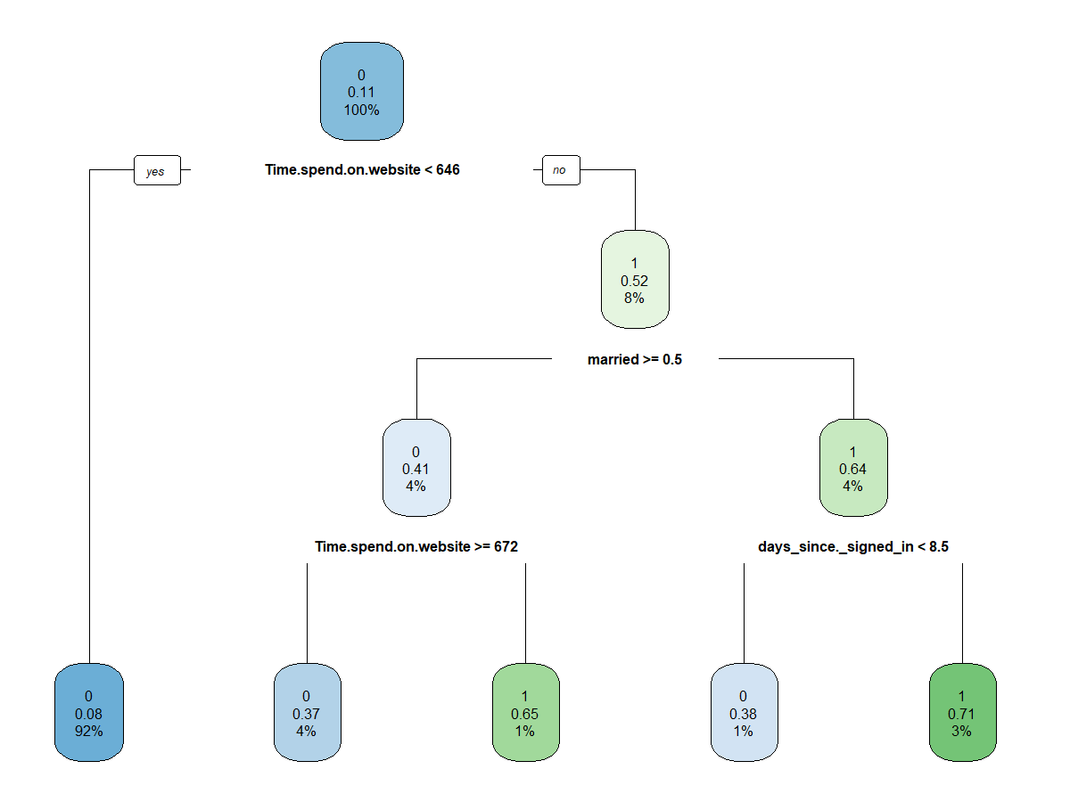
I. COMPILATION OF R CODE
Decison tree R o/p:

Slide 61
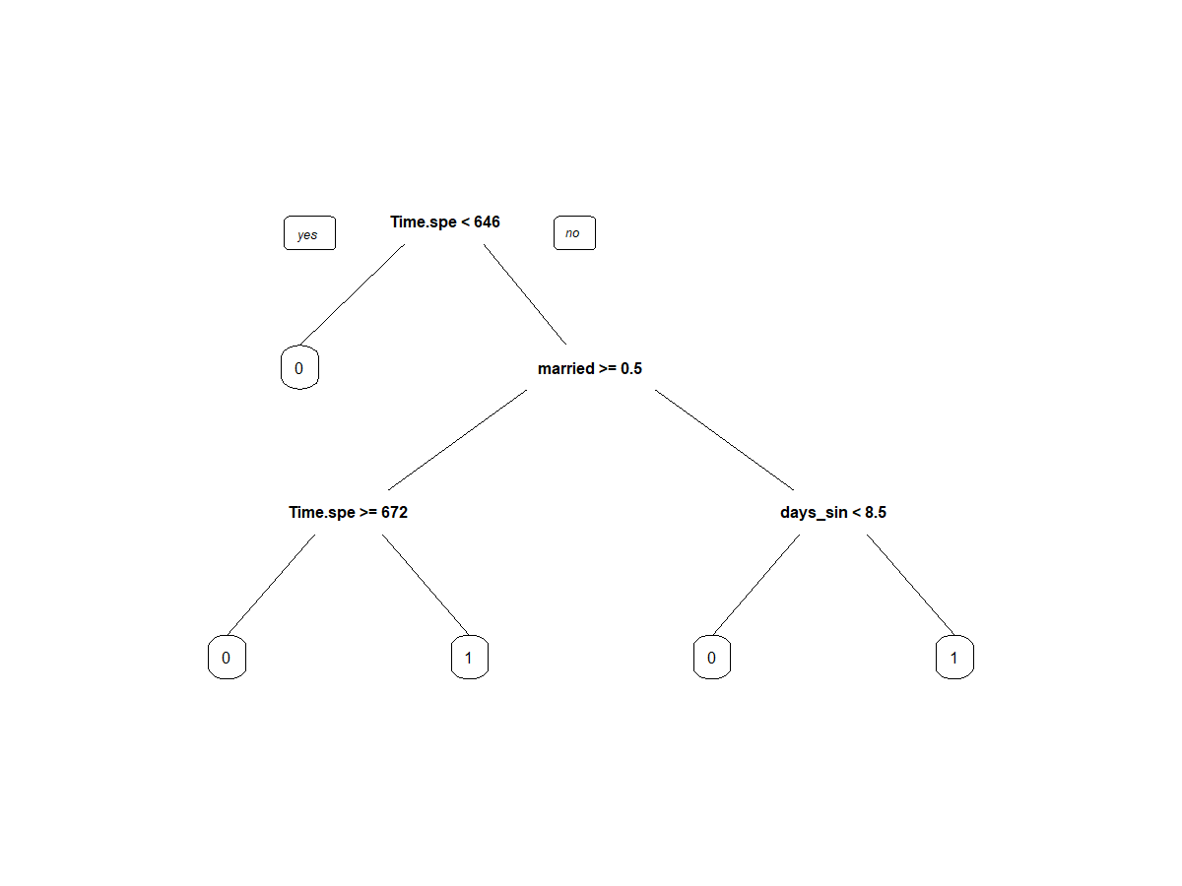
I. COMPILATION OF R CODE
Decison tree R o/p:

Slide 62
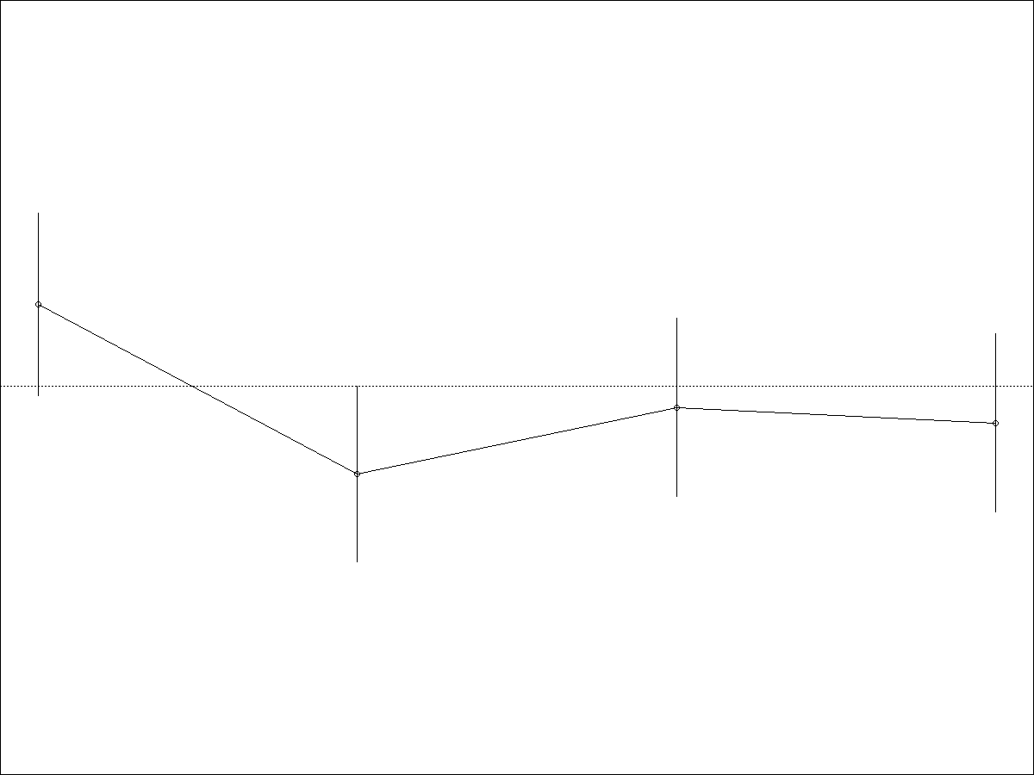
I. COMPILATION OF R CODE
Decison tree R o/p:

Slide 63
I. COMPILATION OF R CODE
Decison tree o/p on train data:
> confusionMatrix(factor(predtr),factor(rf_train$Purchase_Made))
Confusion Matrix and Statistics
Reference
Prediction 0 1
0 2737 281
1 32 76
Accuracy : 0.8999
95% CI : (0.8888, 0.9102)
No Information Rate : 0.8858
P-Value [Acc > NIR] : 0.006487
Kappa : 0.2892
Mcnemar's Test P-Value : < 2.2e-16
Sensitivity : 0.9884
Specificity : 0.2129
Pos Pred Value : 0.9069
Neg Pred Value : 0.7037
Prevalence : 0.8858
Detection Rate : 0.8756
Detection Prevalence : 0.9655
Balanced Accuracy : 0.6007
'Positive' Class : 0

Slide 64
I. COMPILATION OF R CODE
Decison tree o/p on test data:
> confusionMatrix(factor(predtest),factor(rf_test$Purchase_Made))
Confusion Matrix and Statistics
Reference
Prediction 0 1
0 1165 137
1 21 17
Accuracy : 0.8821
95% CI : (0.8636, 0.8989)
No Information Rate : 0.8851
P-Value [Acc > NIR] : 0.6535
Kappa : 0.1379
Mcnemar's Test P-Value : <2e-16
Sensitivity : 0.9823
Specificity : 0.1104
Pos Pred Value : 0.8948
Neg Pred Value : 0.4474
Prevalence : 0.8851
Detection Rate : 0.8694
Detection Prevalence : 0.9716
Balanced Accuracy : 0.5463
'Positive' Class : 0

Slide 65
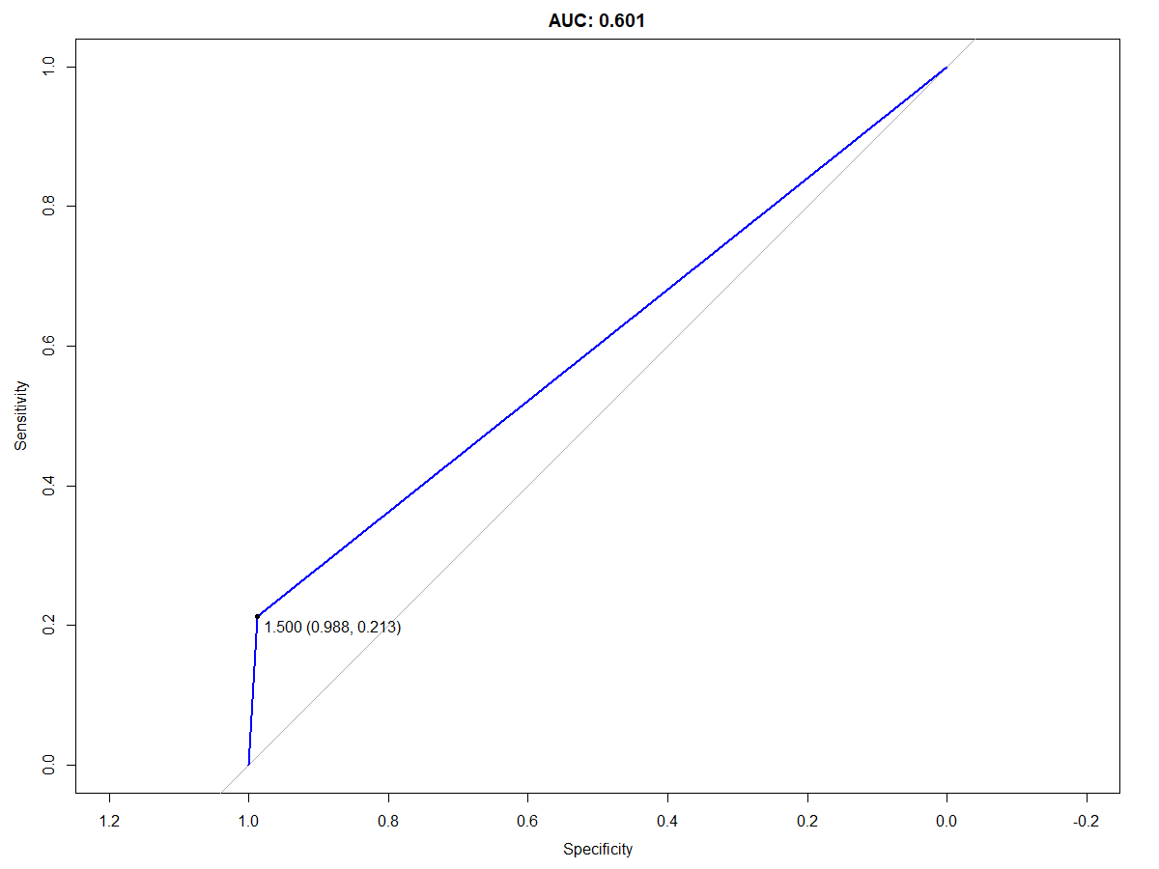
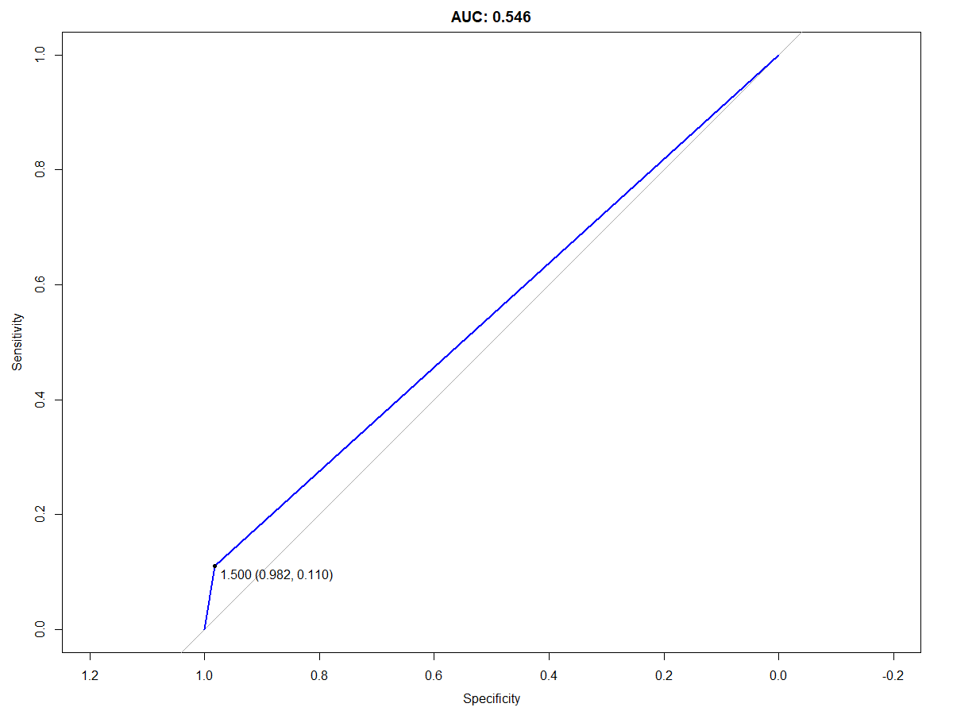
I. COMPILATION OF R CODE
Decison tree R o/p:

Slide 66
II. REFERENCES
Class notes
R documentation

Slide 67
Thank you!

